Slide 1

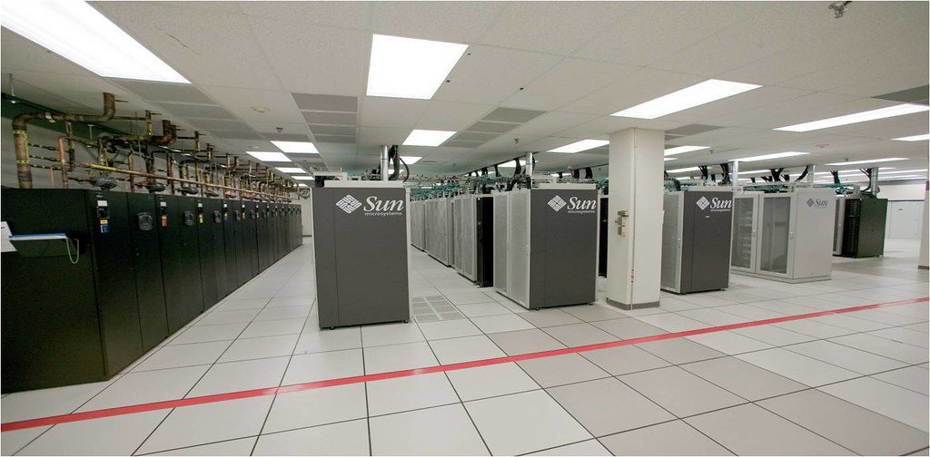

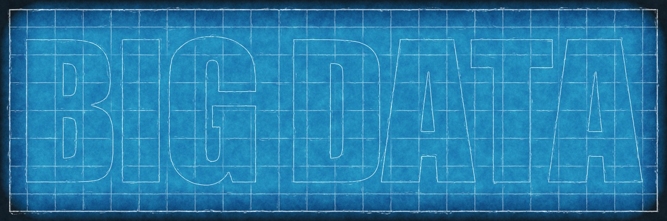

Got Data? Discovery is the Key
Sandia National Labs
Carol Blanch, Solutions Architect
Patrick Carlson, R&D S&E, Computer Science
Tracy Jones, Senior Administrator
SAND2024-03226C

Slide 2
Got Data? Discovery is the Key
Abstract
Data is growing at an exponential rate. Powerful tooling exists that can leverage this data to glean insights and strategic value critical to keeping our competitive edge.
Data Governance – a key component of Data Strategy
Focus Areas for Sandia Data Strategy & Governance
Degrees of Information Usefulness
Data Consumer Challenges: Where is the data? Who grants access? Who understands the data?
What metadata is critical to capture?
How to monitor data and insure high quality and accuracy over time
Sandia’s Enterprise Data Governance team would like to share our experiences with using the Denodo Data Catalog to manage data, share pros and cons, and hear from conference attendees.
During this conversation, we’d like to crowd source ideas for defining Data Governance that can be used by both Mission and Indirect workloads and a common taxonomy for use Enterprise wide.
Examples of data catalog capabilities will be provided.

Slide 3



Presenters
Carol Blanch
Carol is a Distinguished Solutions Architect with 13 years at Sandia National Laboratories and another 15 years in industry. Through the DOE SAFER Program, Carol has been working to share data across sites leveraging modern technologies. Designing resilient systems that deliver robust capabilities, high data quality and advance business opportunities is Carol’s passion. Her work with Sandia’s Enterprise Data Catalog Project is transforming isolated data collections into enterprise assets. Carol earned a Master of Science in Computer Science from the University of California. Previously she graduated with Distinction from the University of Iowa with a Bachelor’s in Computer Science with Honors.
Patrick Carlson
Patrick earned a Bachelor's degree double majoring in Computer Science and Psychology from Simpson College. In addition, he earned a PhD in Human-Computer Interaction from Iowa State University. He has worked as a Data Scientist at Sandia National Lab for the past 7 years. He is passionate about evangelizing the importance of new tooling and culture change at the lab. He works on building out and deploying production ready pipelines that cover the entirety of the data life cycle in support of AI and modeling efforts.
Tracy Jones
Tracy is a Senior Administrator and Data Architect at Sandia National Laboratories. Over 30 years of experience in development and management of Enterprise Financial, Manufacturing, and Human Resource Software including the development of an Enterprise Business Intelligence Portal.

Slide 4
Data Governance – a key component of Data Strategy
Purpose (why we exist)
Data Governance supports data-driven insights and access to data to enable Sandia’s innovation acceleration and modern engineering goals.
Vision (what we aspire to)
Sandia data is securely accessible, understood, and trusted and is used in a consistent, responsible, and meaningful manner to increase interoperability, ensure reliability, and inform decision making in our community.
Mission (what we do)
We design and implement policy and standards to enable data management and data sharing in order to support regulatory compliance, internal reporting & analytics, operational analytics for our business, data integration, and Artificial Intelligence (AI) and Machine Learning (ML) innovation and operations.

Slide 5
Focus Areas for Sandia Data Strategy & Governance
Enterprise Asset - Advocate the treatment of Sandia data as a corporate and government asset
Use Ready - Enable access and use of data for timely data driven decisions
Ease of Use - Support and develop mutually beneficial standards and practices to provide efficient and effective access to data
Support Community - Develop and socialize the responsibilities of Data Stewards
Taxonomy - Align the organizational strategies, digital transformation and data strategy, and data governance objectives between Enterprise and Mission Data Governance Efforts
Funding - Secure support and funding for agreed upon data strategy and data governance efforts
Communication - Provide organization-wide visibility to and flow-up / flow-down communication of data strategy and data governance efforts
Data Management Standards - Federate governance across program and mission areas

Slide 6
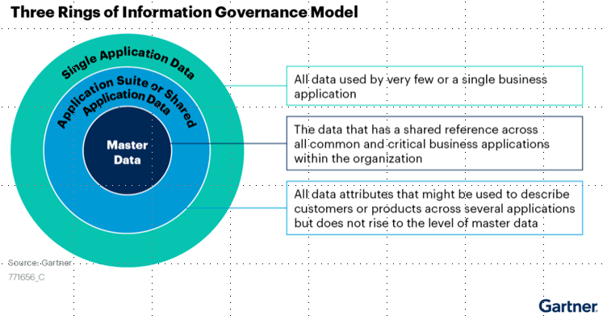
Degrees of Information Usefulness
Data has different levels of usefulness or importance
Sandia has two main groups of data, Corporate (NTESS) and Government Data (NNSA/DOE)
The more important the data, the more metadata is necessary to manage the data
Data Management includes collecting, organizing, protecting and storing data

Slide 7
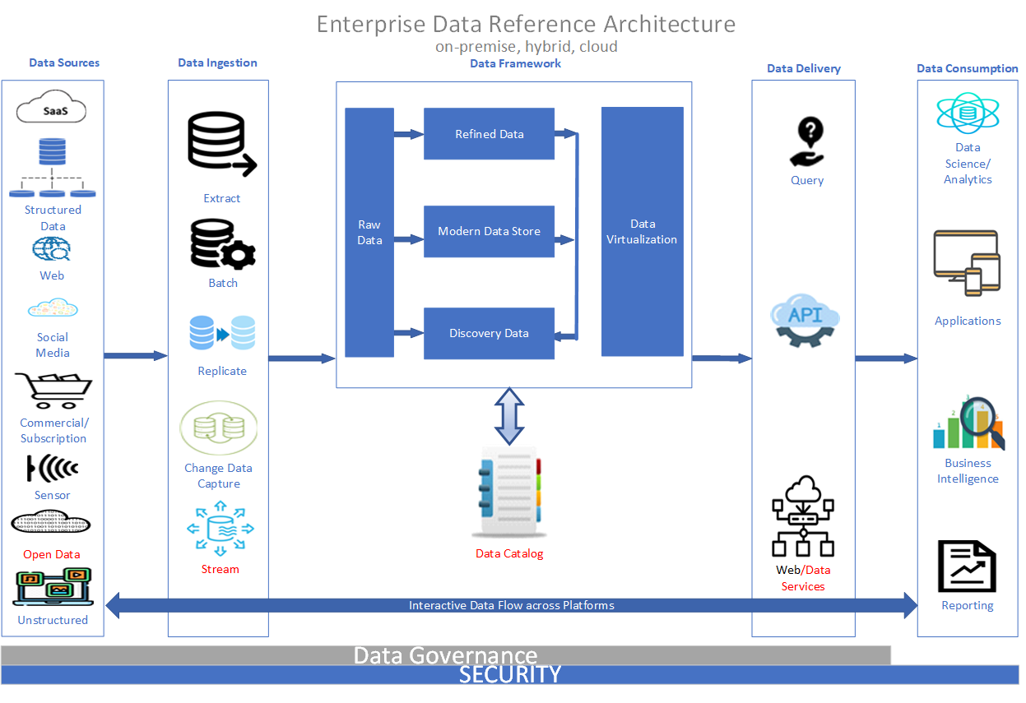
Data Consumer Challenges in a Growing Complex Ecosystem
“data lifecycle”

Slide 8
Sandia Data Strategy & Governance Board Structure
Who do we talk to about the data?
Sandia Data Strategy and Governance Board
(Directors)
Executive Level
Sponsors the Governance program
Provides supporting leadership
Sets the direction and business strategy
Supports data and technology requirements
Incorporates broad laboratory strategy and responds to emergent needs
Enterprise / Mission Data Governance Board/s
(Senior Managers)
Strategic Level
Responsible for data governance process
Leads the governance program at tactical level within the domain or program
Mission areas must establish parallel structures here (like ND has already done)
Enterprise / Mission Data Governance Working Team/s
(Managers and Individual Contributors)
Execution / Tactical Level
Executes the Data Governance
activities and process for the domain
Works with identified Data Stewards
Creates the Data Architecture
Data Users

Slide 9
Data Integration Benefits
Converts Local Data Assets Data to Enterprise Assets
Single source of truth
Make data discoverable
Show metadata and descriptions
Dynamic Role-Based and Attribute-Based access control methods
Grouping, tagging, and masking of data
Notes:
The Denodo Data Catalog provides several strategies to help you discover your valuable data resources. You can:
Search by relevant terms in your catalog, using both the metadata of the data resources and their actual data as well.
Organize your data resources in categories and browse them.
Receive automatic recommendations of data assets according to your interactions.
Inspect which data assets are important for other users in your company.
Navigate through the views related to one view valuable for you.
You can check the fields that compose a data resource and study how they are built on the fields of other resources.
Statistics on how other users consume a data resource are available.
You can improve the descriptions from the Denodo servers.
You can add tags to them.
You can extend the metainformation about a data resource with whatever custom property you need.
In a collaborative way, users can support some data assets or discourage you from using them.
Use Role Based Access Control and Attribute Based Access Control to provide access to those authorized to see the data, just the metadata.

Slide 10
Data Integration Benefits cont.
Data Discovery
Gartner cites this is the #1 challenge for data management.
Provides one centralized security layer to manage and audit data usage.
Provide Lineage
Analysts are often asked to describe where data came from, data freshness, etc.
Forrester reports an average 364% ROI for implementing data catalogs primarily from saving analysts, data scientists and others as much as 80% of their time previously spent searching for data, how to request access, or who is domain expert.
Provides workflows, ticket integration, and policies through which to govern data.
Enables zero-trust through data categorization such as sensitivity labels.
Support Data Governance & Security
Trusting Data
Data Catalogs allow for interactions from data users to indicate their usefulness.
Authoritative Data Stewards can certify highly trustworthy data sources.
Lineage within a data catalog greatly facilitates this in a semi-automated fashion.

Slide 11
Data Catalog History
Tried many different data catalogs over the years!
Custom in-house catalog and front-end UI
Wanted more features and functionality
CKAN (Open Source)
Migration from Python 2.X to Python 3.X was slow, EOL
Collibra (COTS)
Lots of features, UI was complicated for users
Denodo (COTS)
Data delivery and catalog in one place
Notes:
The Denodo Data Catalog provides several strategies to help you discover your valuable data resources. You can:
Search by relevant terms in your catalog, using both the metadata of the data resources and their actual data as well.
Organize your data resources in categories and browse them.
Receive automatic recommendations of data assets according to your interactions.
Inspect which data assets are important for other users in your company.
Navigate through the views related to one view valuable for you.
You can check the fields that compose a data resource and study how they are built on the fields of other resources.
Statistics on how other users consume a data resource are available.
You can improve the descriptions from the Denodo servers.
You can add tags to them.
You can extend the metainformation about a data resource with whatever custom property you need.
In a collaborative way, users can support some data assets or discourage you from using them.
Use Role Based Access Control and Attribute Based Access Control to provide access to those authorized to see the data, just the metadata.

Slide 12
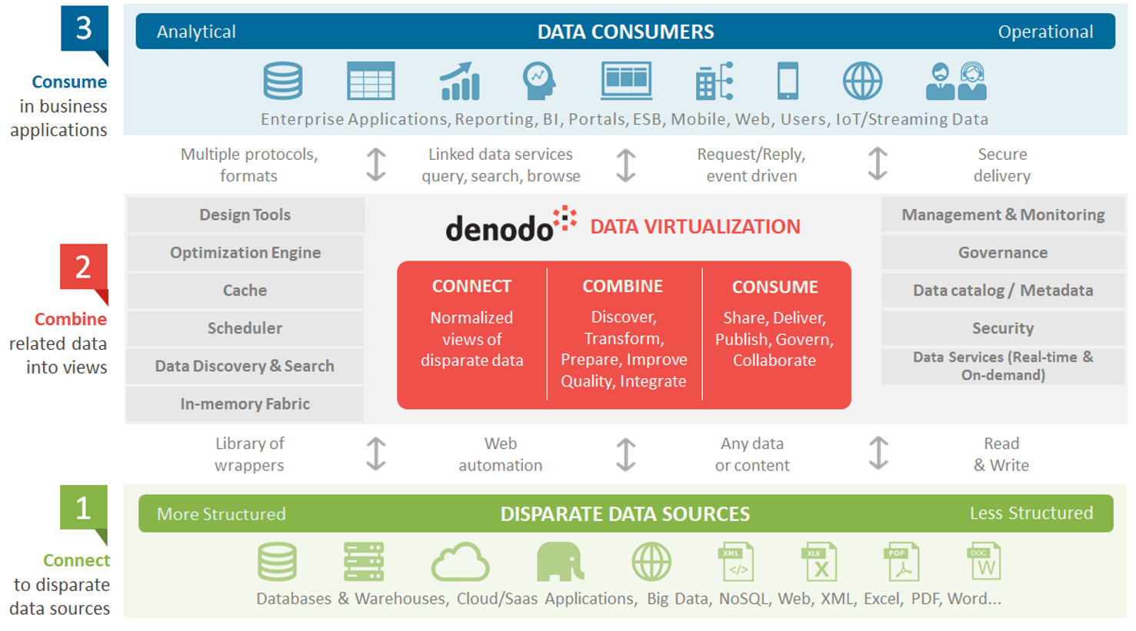
Denodo Data Virtualization
https://www.datavirtualizationblog.com/data-integration-made-easy-fast/denodo-architecture-2/
Notes:
The Denodo Data Catalog provides several strategies to help you discover your valuable data resources. You can:
Search by relevant terms in your catalog, using both the metadata of the data resources and their actual data as well.
Organize your data resources in categories and browse them.
Receive automatic recommendations of data assets according to your interactions.
Inspect which data assets are important for other users in your company.
Navigate through the views related to one view valuable for you.
You can check the fields that compose a data resource and study how they are built on the fields of other resources.
Statistics on how other users consume a data resource are available.
You can improve the descriptions from the Denodo servers.
You can add tags to them.
You can extend the metainformation about a data resource with whatever custom property you need.
In a collaborative way, users can support some data assets or discourage you from using them.
Use Role Based Access Control and Attribute Based Access Control to provide access to those authorized to see the data, just the metadata.

Slide 13
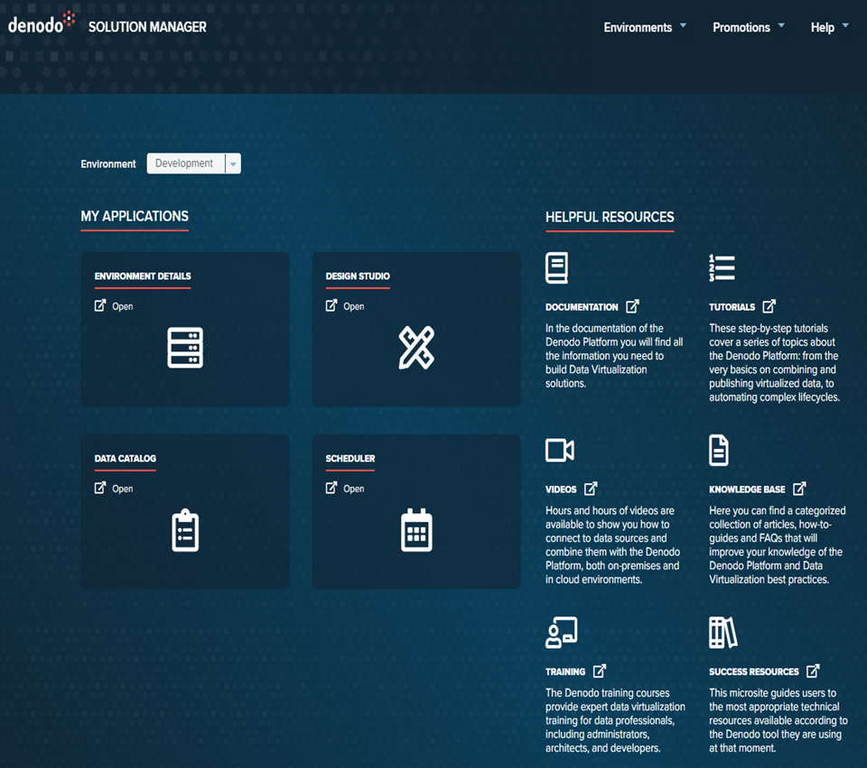
Surfacing Data with Denodo
Denodo Solution Manager
Denodo Design Studio
Create Virtual Database (VDB) Access
Policy Based Access
Role-Based Access Controls (RBAC)
Attribute-Based Access Controls (ABAC)
Denodo Data Catalog
Enrich with metadata
View lineage
Search by keyword
Filter fully curated data sets
Surface data (once access is granted)

Slide 14
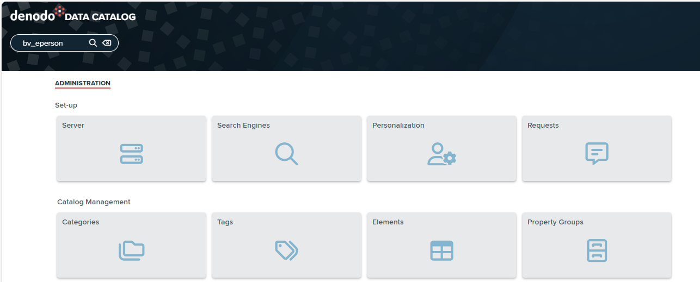
What metadata is critical to capture?
Three customizable metadata options
Tags – independent, individual tags
Categories – defined with a hierarchical relationship to one another
Property Groups – set of customized metadata fields that stay together

Slide 15
Denodo Pros
Web UI is relatively easy to navigate
Unlimited catalog editors, licensing per core not per user
Query data from within the catalog
Denodo lineage shows provenance and dependencies between tables
Open data into PowerBI or Tableau with a single click
Singular integration point and access controls enable easy data governance
Column descriptions defined once at “base view” and flow to dependent views
Good customer engagement with vendor
Denodo Challenges
Encountered many bugs and breaking features
Backend server challenging to maintain
Substantial amount of time testing and working with the vendor
ABAC access control policies are difficult to debug

Slide 16
Future
Federated data access, cross-site data connectivity
Cross-site alignment on metadata, governance, tagging, etc.
AI and model governance and cataloging
Ties into software governance
Inventory of deployed models just as important as data!
Generative AI governance
Models will need access to large amounts of data
National Institute of Standards and Technology (NIST) AI Risk Management Framework (RMF)
Securing data, data pipelines into indexing, and model delivery all still require access controls and need-to-know (NTK)
Mature data governance, improve culture, decrease time to review and deliver data

Slide 17

Questions or Comments?
Use Cases
Data Delivery
Lessons Learned
Value
Users
Security
Opinions
Processes
Access Controls
Future Direction
Benefits

Slide 18
Appendix

Slide 19
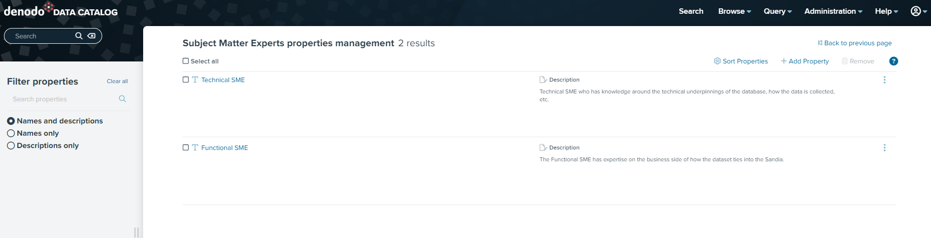
Who do we talk to about the data? cont.
Metadata assigned to each table in Denodo Data Catalog

Slide 20
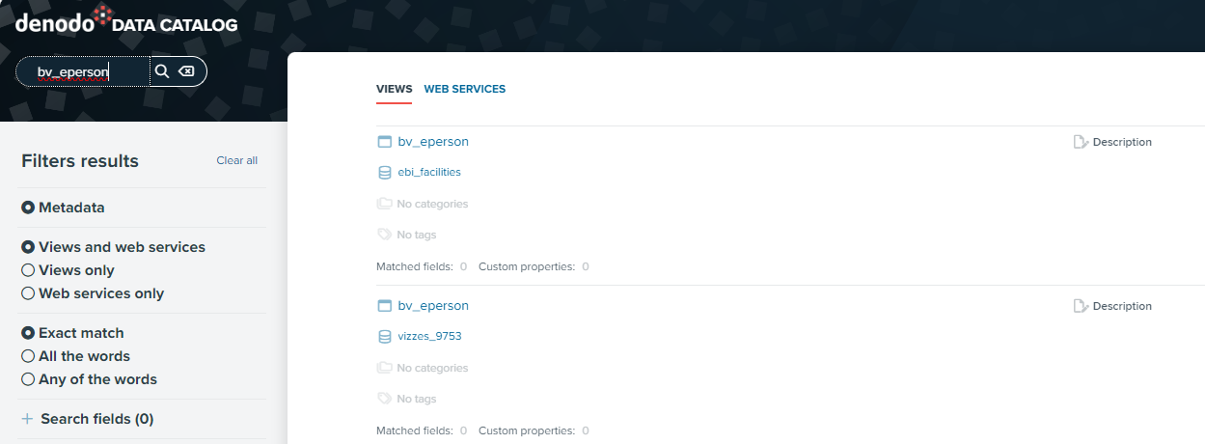
How do we get access to the data?
Access to Metadata for all users
Access to data by Metagroup through Subject Matter Expert
Role Based Access Control (RBAC) – Metagroup by Table or Database

Slide 21
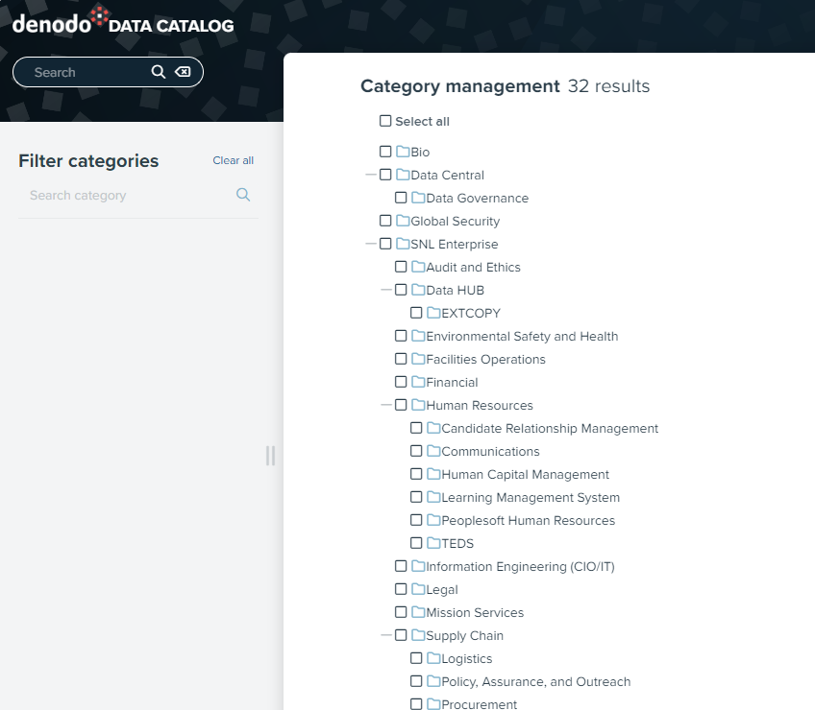
What metadata is critical to capture? cont. - Categories

Slide 22
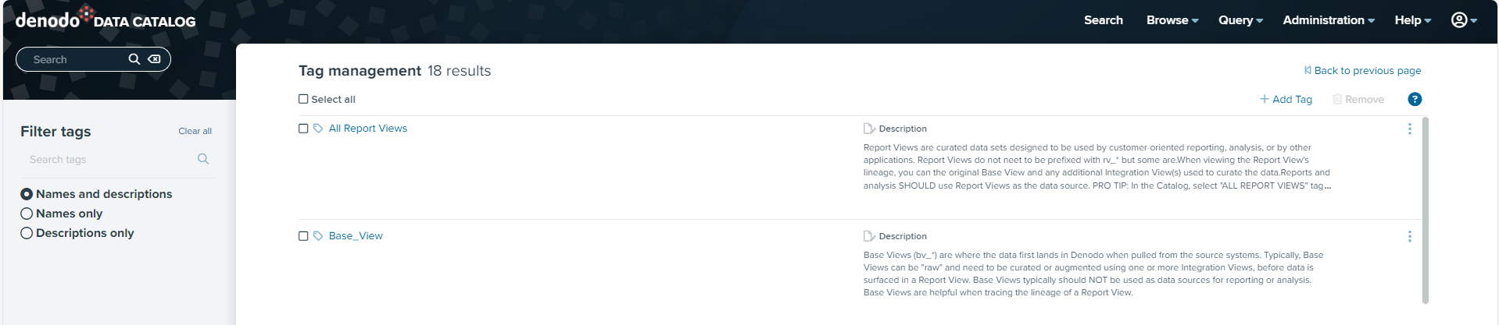
What metadata is critical to capture - Tags

Slide 23
What metadata is critical to capture – Property Groups

